Slide 1
Going Dutch
Team No.: 126

Slide 2
Going Dutch team :
Guide – Dr. Murugeswari
Reviewer – Dr. Varshali Jaiswal
Izna – 20BCE11021
Chandrika Sharma – 20BCE11032
Vishvas Patel – 20BCE10993
Sambhav Mehta – 20BCE11033
Radheshyam B Soni - 20BCE10994

Slide 3
You might pay the bills, but I am not
ready to pay the price so,
Let's split!

Slide 4


INTRODUCTION
Let’s Go Dutch !
Going on a road trip ? Worried about all the math you gotta do to find out "who owes whom and how much" after the trip? Well, worry not! Add all your expenses to our app and let it do the calculations for you.
“Let’s go Dutch”, is a phrase that has become extremely common in terms of usage and popularity among the masses lately.
The term indicates that each person in the group while dining out or working pays for their own share. The practice of splitting bills is more popular among the youth, as the masses are becoming more financially independent and have become used to paying their own bills.

Slide 5
“Going Dutch”, a phrase that arguably owes its origin to a door a traditional Dutch farmhouses door consisted of two equal parts - is common practice today.
But most likely, the roots of "splitting the bill may be related to Dutch etiquette. In the Netherlands, it's not unusual to pay separately when working or going out as a group. But the big question - after you have decided that you are going Dutch - is how? Technically, going Dutch means separate tabs, each person pays for himself or herself.

Slide 6
OBJECTIVE
Mobile application have become a part of day-to-day life. Many application are available in the market to manage personal and group expenses. Not many application are reliable or are able fulfil the user requirements.
In this project we have designed a mobile application that managers a person’s all expenses, their personal contribution toward group expenses, maintain monthly income, recurring payments. It provides information of "who owes who and by how much".

Slide 7
The proposed application would eliminate sticky note, spreadsheet and ledger that cause confusions, data inconsistency problems while recording and splitting of expenses.
With our application user can manage these expenses more effectively. This application does not only helps users to manage their expenses but also help marketing executives by providing them the platform they need.

Slide 8
HARDWARE AND SOFTWARE REQUIREMENTS
SECURE
FAST AND RELIABLE
For User​
Android device with android 5 or above
It doesn’t require internet connection and works offline
ACCESSIBLE

Slide 9
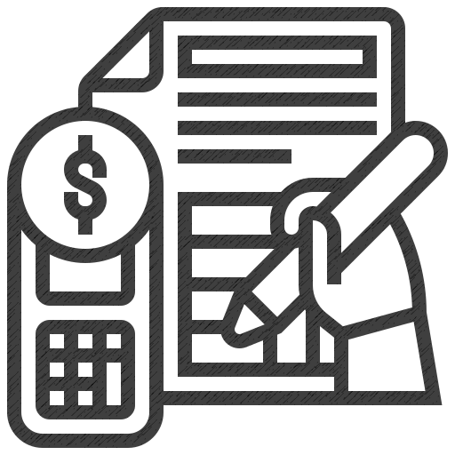
PROPOSED WORK & METHODOLOGY
It is a mobile application intended to run on android devices. It is design to fulfil the needs of the user by reducing their efforts for the settlement of the bill.
The application encourages corresponding users help in who owes who, and for what.
Aim to provide user the best approach to help user and their companion to share expenses easily.

Slide 10
This application lets bunch users together and their companions to have detailed view inside this application around the individual costs and to settle them.
This application allows its user to add remark to an expense, click on the expense name in any expense list. Bill posting has space for comments. It is also supposed to have the notification option (still not incorporated) to notify each time somebody adds a remark to an expense user is on, or user can withdraw to posted bill.
It has our algorithm that calculates to last digit precisely who must take or give how much to whom. It makes it easier to calculate and settle payments for a big event or even a small restaurant bill

Slide 11
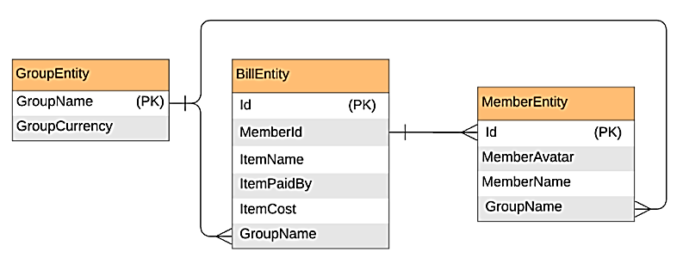
Database diagram

Slide 12
Features concepts (final may vary)
No user login and registration required
Uses a O(n) algorithm to settle debts
Built in Java for Android Platform
Recycler views
Fragments & View Pager
Activities & intents
Room Persistence, Live Data, View-Model
Different types of layouts

Slide 13
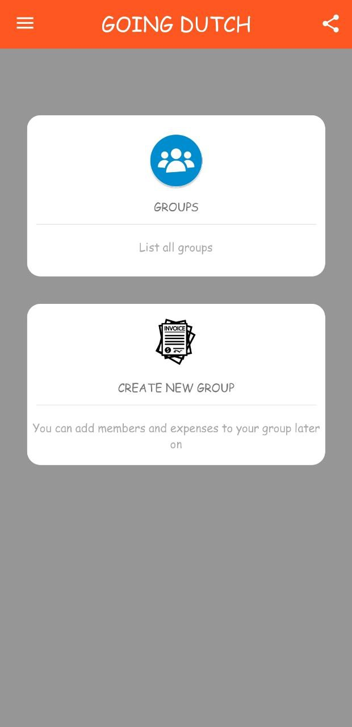
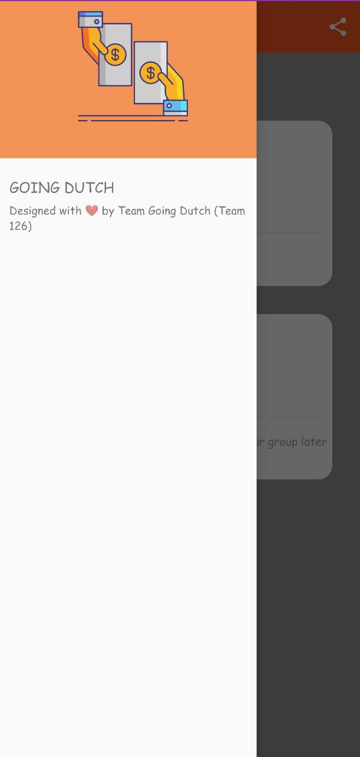
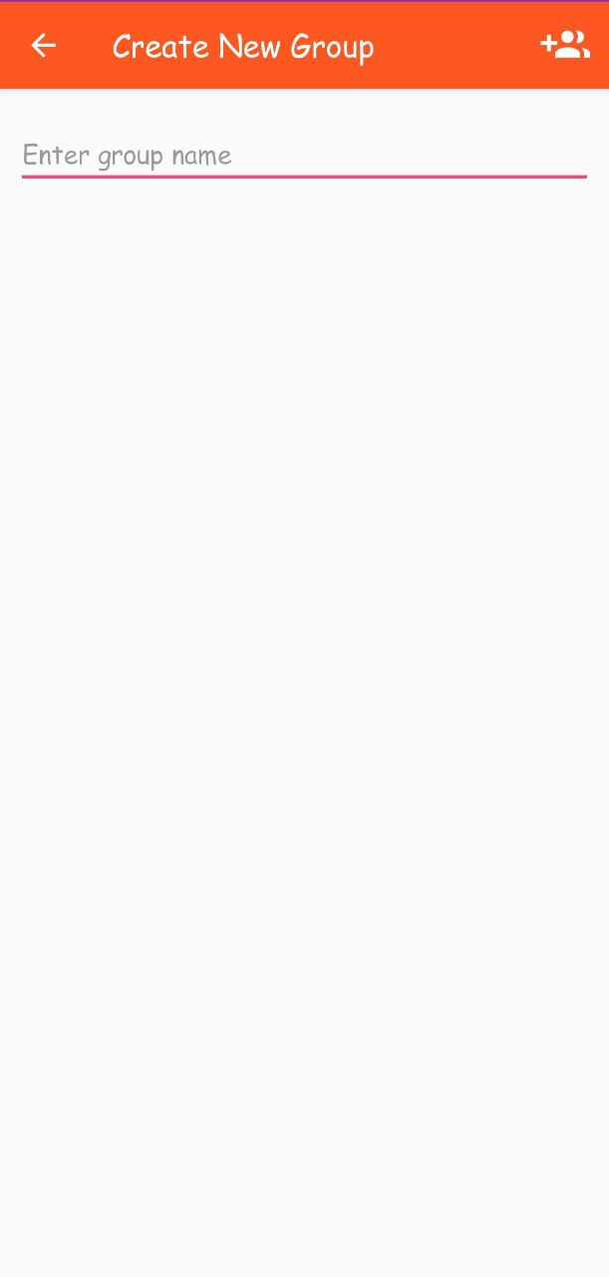
Sample screenshots

Slide 14
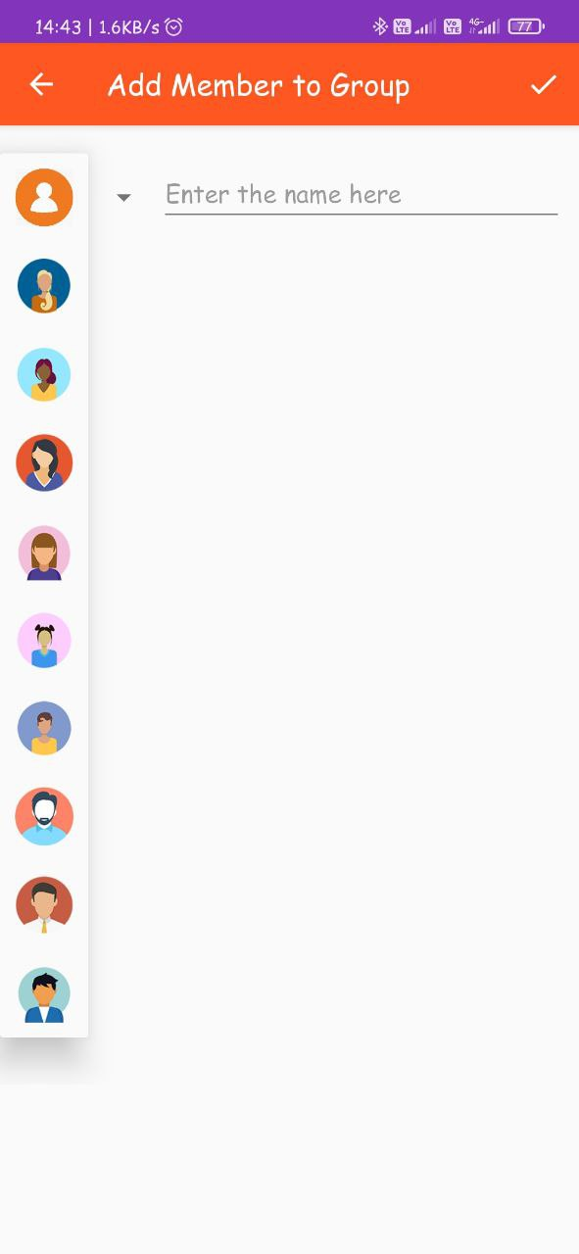
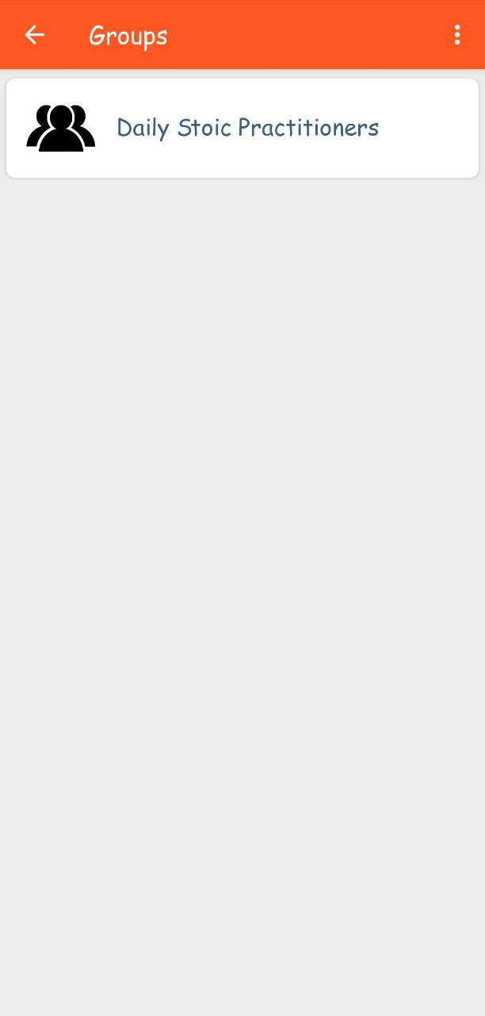
Sample screenshots

Slide 15
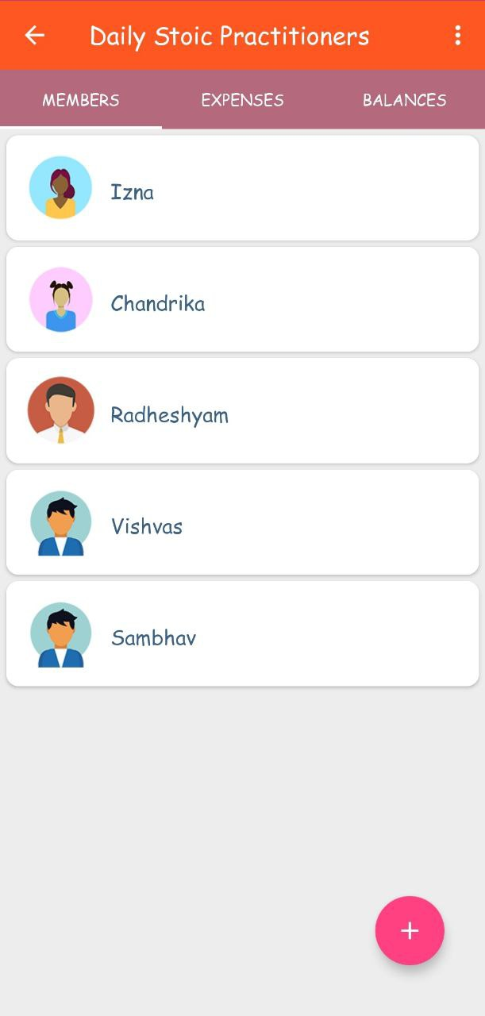
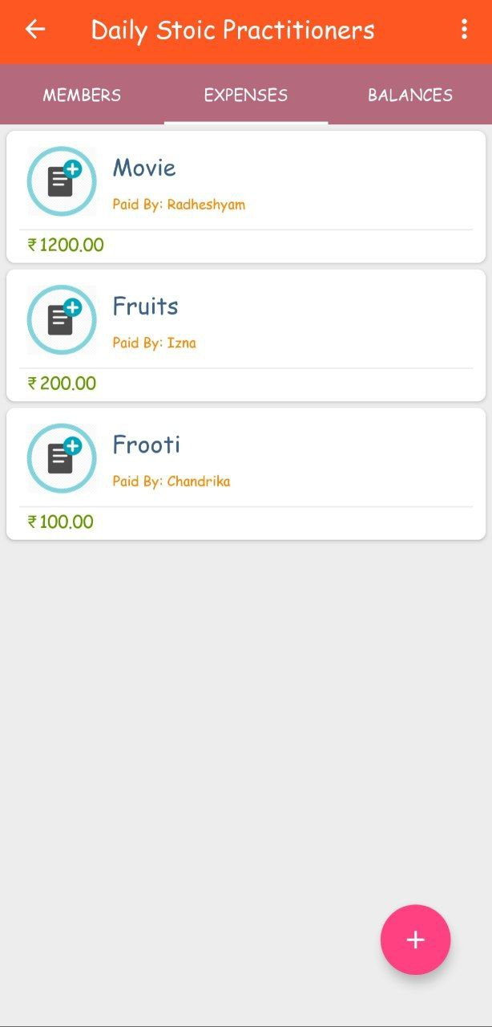
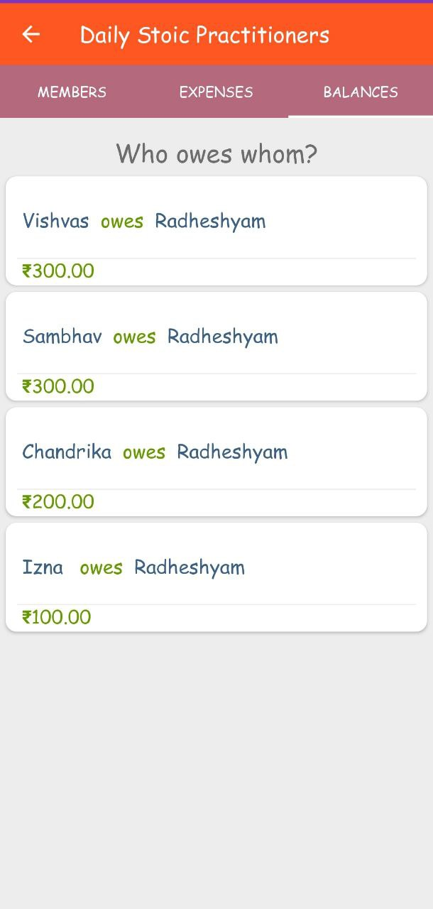
Sample screenshots

Slide 16
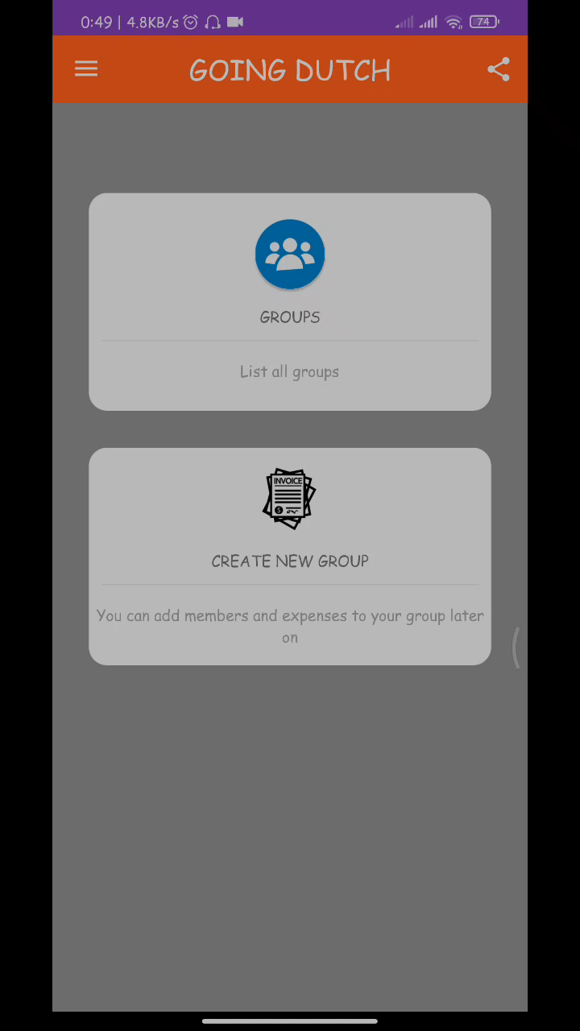
Demo

Slide 17
Algorithm used for settling debts
Calculate Balances: Find the balance of everyone in the group.
Ex:
Initially:
Member Expenses
(Contributions made by the member) ----------- --------- A 1000
B 800 C 500 Total 2300
Divide Total/NoOfMembers = 2300/3=766.66(let's call this as eachPay).
Ex: For member A, balance = eachPay - expenses of the member=766.66-1000= -233.33.
Negative balance - individual is owed money
Positive balance - individual owes money to the group

Slide 18
Algorithm used for settling debts
Final Balances:
Member Balances ----------- --------- A - 233.33
B -33.34 C 266.66
Calculate Transactions:
Largest elements from the debtors and creditors list.
Ex: If debtors = {4,3} and creditors={2,7}, pick 4 as the largest debtor and 7 as the largest creditor .
The debtor with a balance of 4 receives Rs. 4 from the creditor with a balance of 7 and hence, the debtor is eliminated from further transactions.

Slide 19
Algorithm used for settling debts
Optimization :
Correct results
No of transactions is not minimum.
To minimize - subset sum algorithm (NP problem).
NP solution - slow down the app.

Slide 20

TIMELINE OF OUR PROJECT
Review 1
Review 2
Problem Identification​
January 22
March 3
April 16
Generation of Ideas & Solutions​
Final Preparation
Implementation of ideas
Review 3
January 21
Presentation of Ideas​
Presentation of Implementation
Poster Presentation and demo
February 16
March 27
April 23

Slide 21
CONCLUSION
We have developed this application to help user to track his/her contribution towards group expenses.
We aim to make our application good enough to show “who owes who and by how much”.
This application reduces human efforts for the settlement of the shares.
It also minimizes the human interfere in the splitting process which leads to the most accurate results.
The results obtained are accurate for the performed operations on the application.
This application does not only help user to maintain expenses but also settle the expenses on the spot which could be the hectic process.

Slide 22
REFERENCES
Presentation template by Slidesgo
https://medium.com/@POSist/splitting-bills-going-the-dutch-way-e3163f319e21
Developer.android.com
https://www.splitwise.com/terms
https://www.xpenditure.com/en?
Fundamentals of Database systems – book by Elmasri and Navathe
Data Mining and Analysis: Foundations and Algorithms, Mohammed J. Zaki and Wagner Meira,
Jr, Cambridge University Press, 2013

Slide 23
THANK YOU !

